Slide 1
Kuwait Petroleum Corporation
(KPC)
History – Political Disputes
  1970s- KPC
  KPC has struggled
Nationalization eventually gave up many subsidiaries
KPC suffers from excessive bureaucracy
Oil sector devoid of strategy
Root cause – fragmented and dysfunctional political system

Slide 2
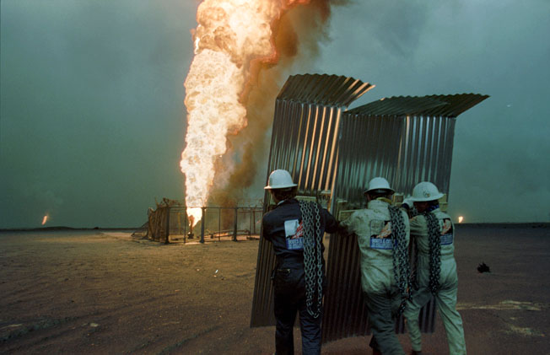
War

Slide 3
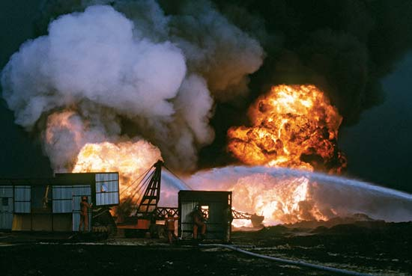
War

Slide 4
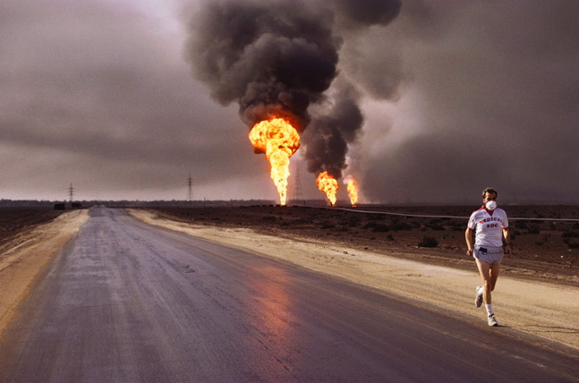
War

Slide 5
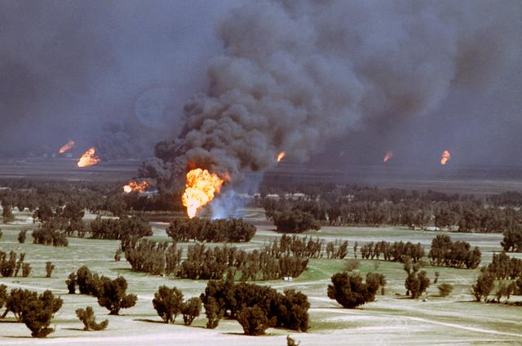
War

Slide 6
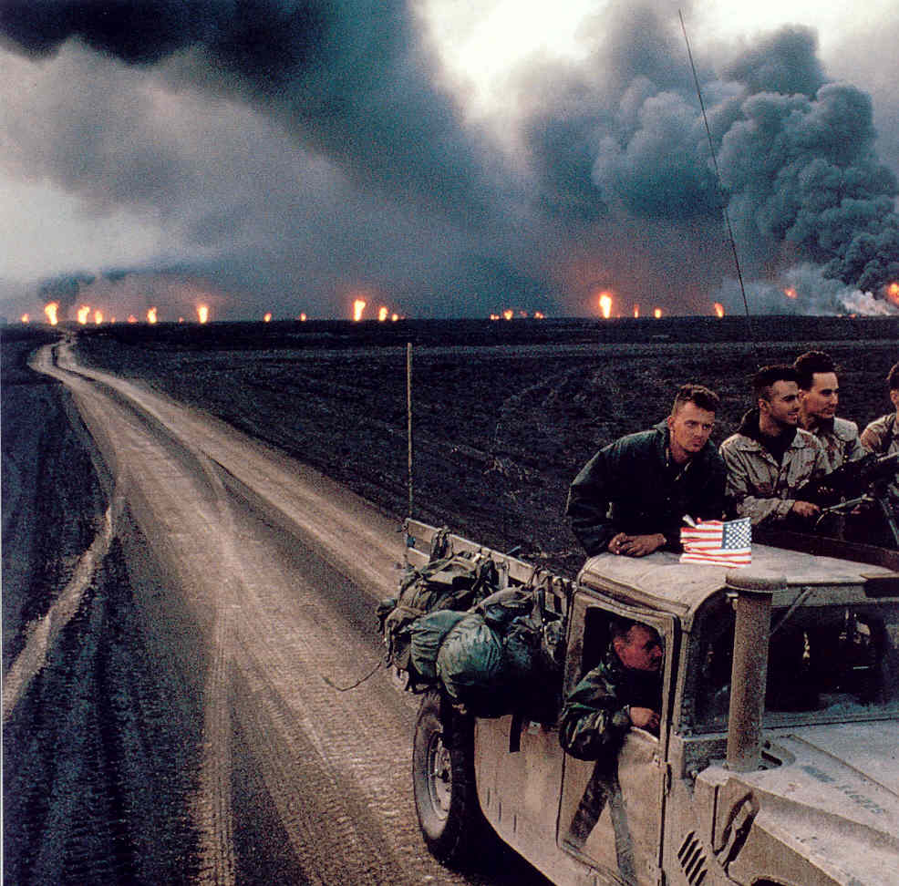
War

Slide 7
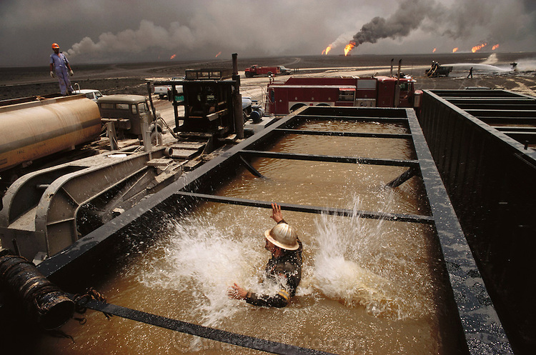
War

Slide 8
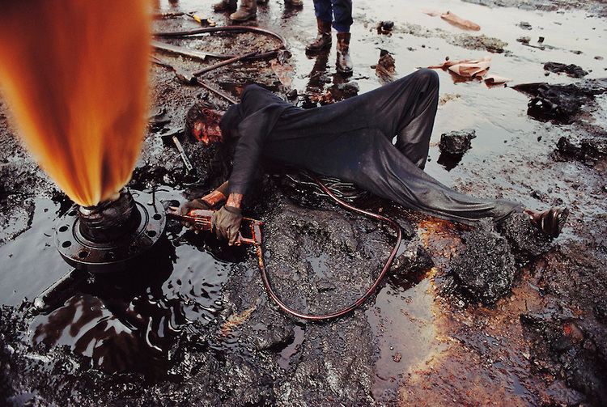
War

Slide 9
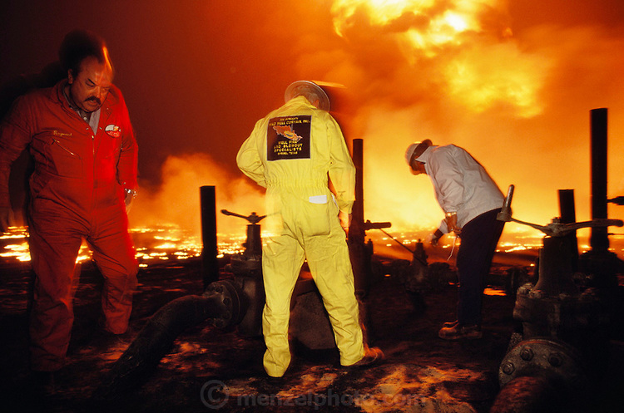
War

Slide 10
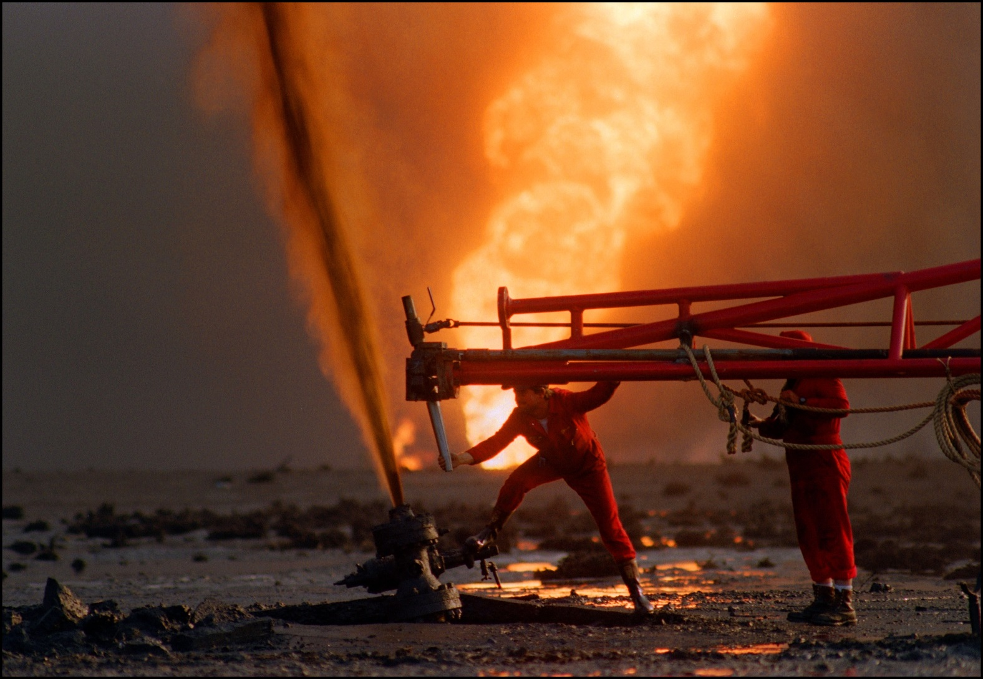
War

Slide 11
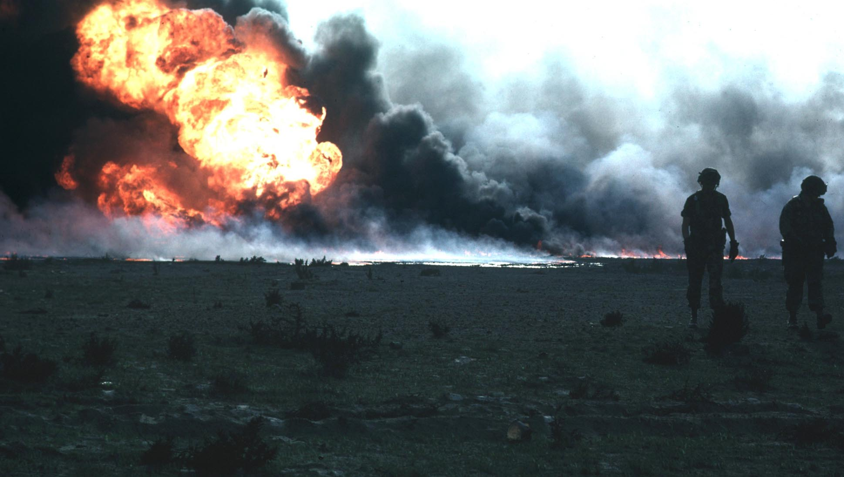
War

Slide 12
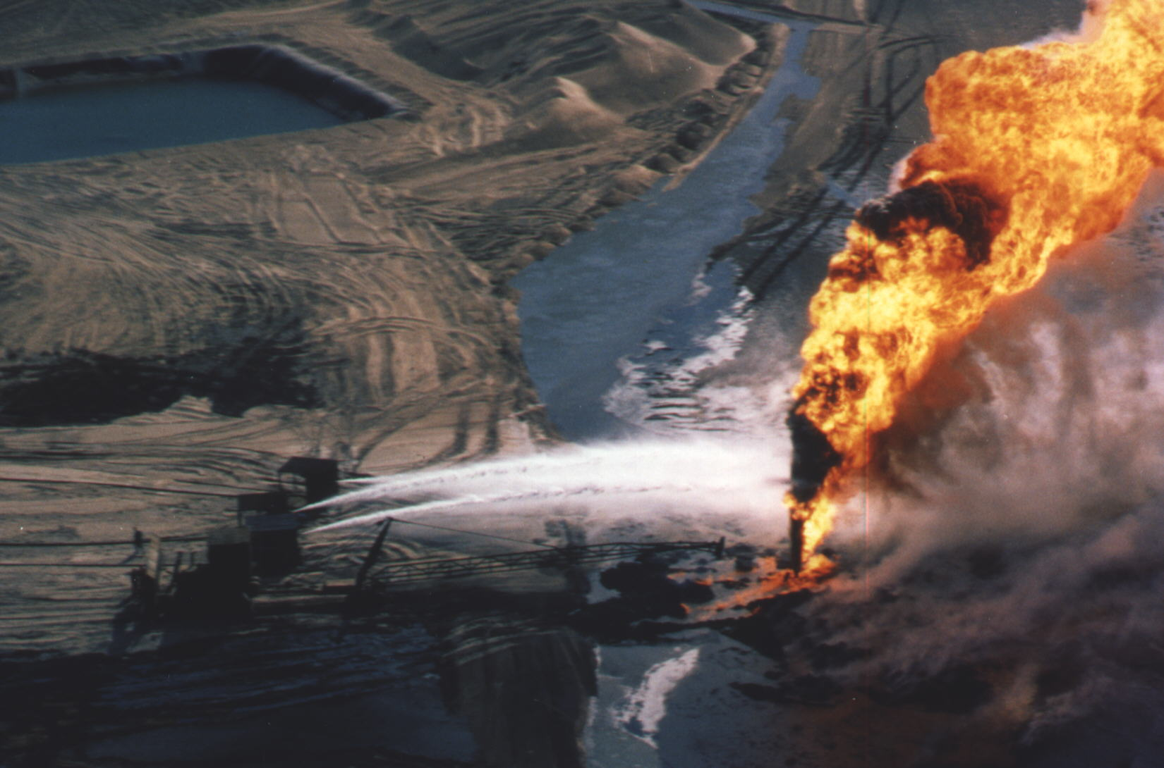
War

Slide 13
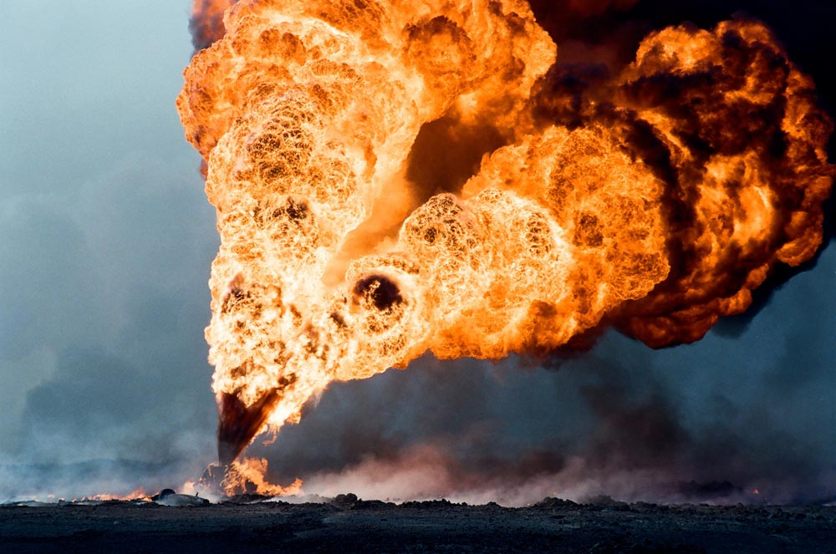
War

Slide 14
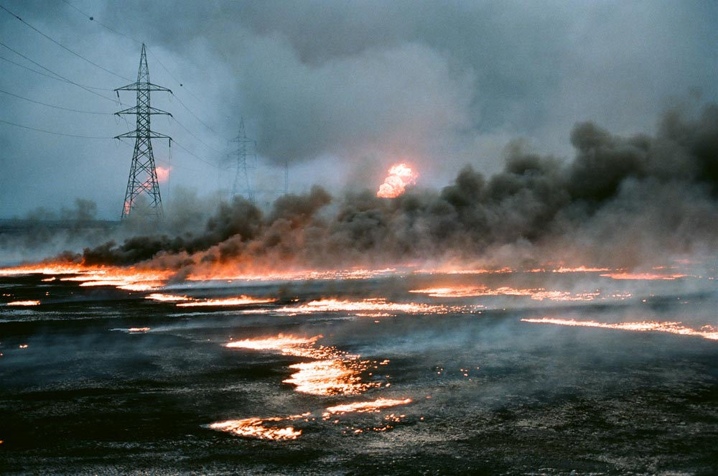
War

Slide 15
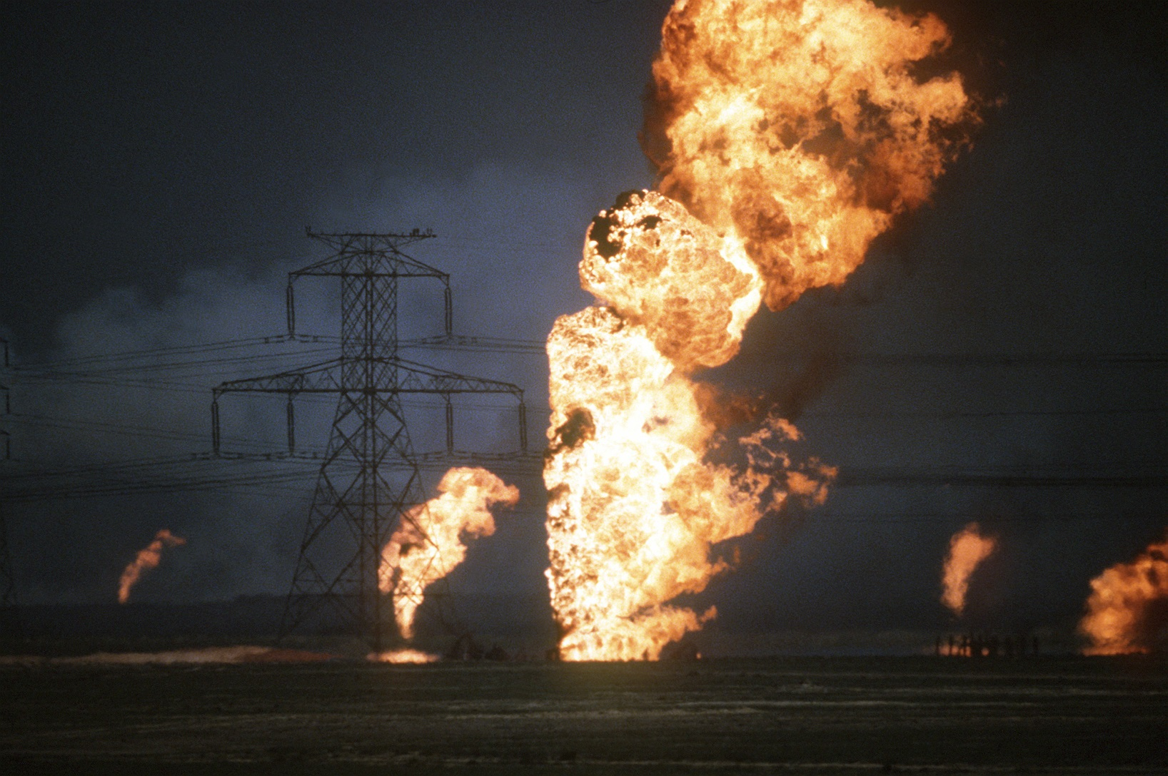
War

Slide 16
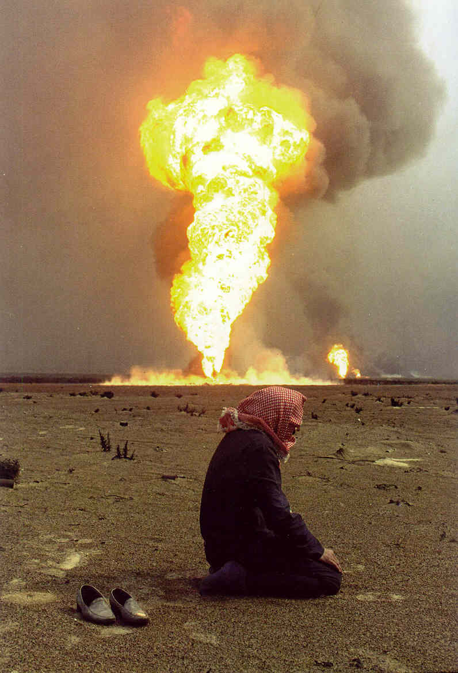
War

Slide 17
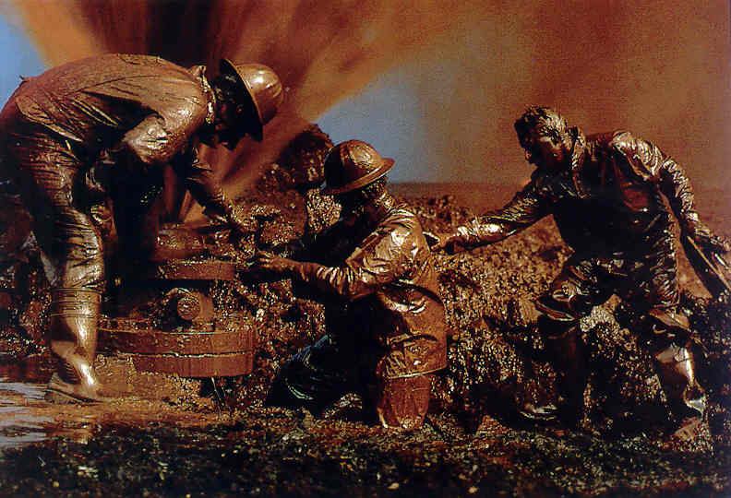
War

Slide 18
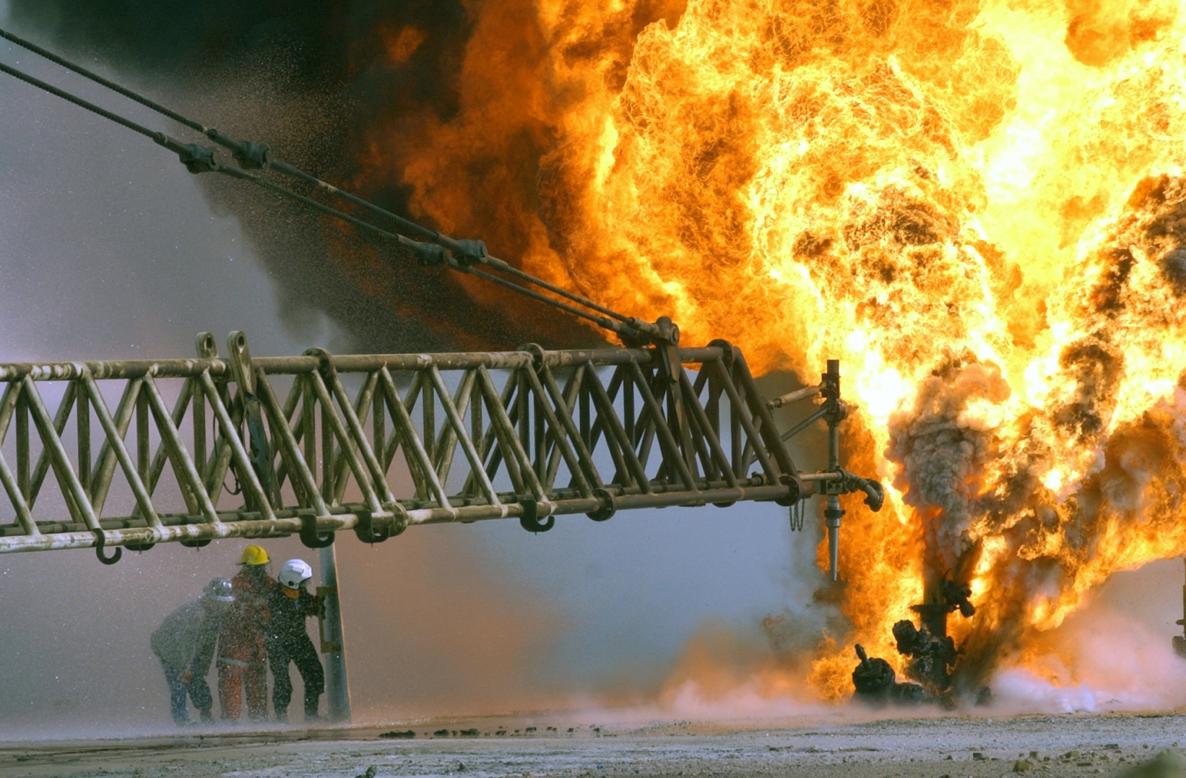
War

Slide 19
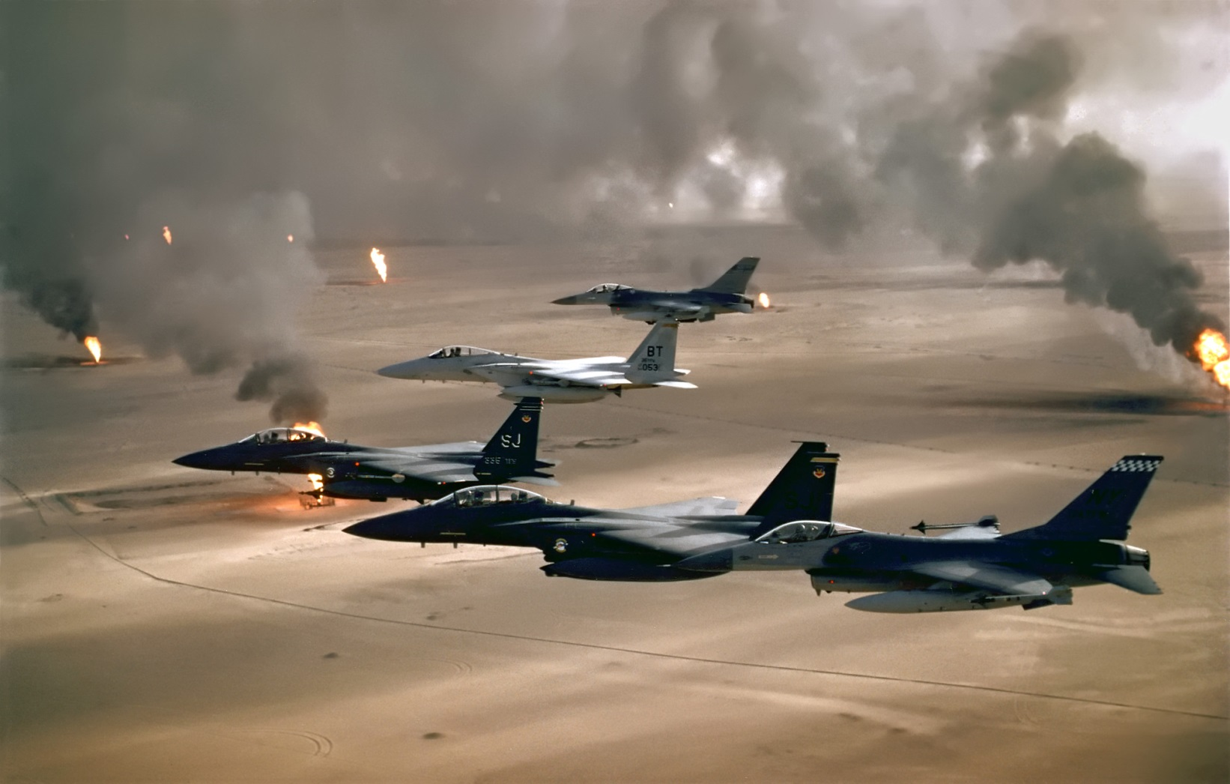
War

Slide 20
Since 1991
Oil sector been in gridlock
Reforms adopted after Iraq invasion and liberation
Authority split
Unpopular decisions easy to veto – as in Mexico
Gov’t unable to focus on reform
Six oil ministers since 2000
Entire oil sector gridlocked

Slide 21
Results
Performance and strategy hard to measure
Efficiency of performance hard to measure
Unlike other NOCs, KPC and affiliates produce annual reports
In theory, possible
Low upstream costs- normal for favorable geology
Authors believe performance quite poor

Slide 22
Targets
Many missed adjusted targets
Pushed capacity of 3,000,000 b/d – 2004 to 2011
1% gas flaring target delayed to 2011
Postponed forth refinery
Three major accidents in domestic refineries

Slide 23
Upstream
Failed to sustain production
Growing difficulty as fields mature
“Project Kuwait” – outside investment to expand
  Stalled politically

Slide 24
Central Arguments
First failure of KPC due to Kuwait’s dysfunctional political system
Lack of accountability between gov’t and the national assembly
KPC is subject to an intrusive and erratic administration
Discourage risk taking
Merely attacking KPC is a proxy for assembly to challenge the gov’t
KPC must follow onerous procurement rules (mirror’s Mexico)

Slide 25
Kuwaiti Law
Cumbersome, complex, unpredictability, horribly bureaucratic strategic choices – need four decision steps in Western companies
Endure a phalanx of thirty-six decisions in Kuwait
In Kuwait, blocked by barriers in Kuwait law and high turnover in oil ministers
Difficult to cope with environment

Slide 26
Secondly- Strikingly weak middle-level management
Especially true in technical/engineering
People given posts for which not knowledge or experience
Is a reflection of government-laden system with political interference in promotion
Thirdly, high oil prices have masked all three problems
Small population and large accumulated reserve funds
An alternate strategy – opening the sector to outside companies difficult to adapt

Slide 27
Upstream
KPC aware of growing problem
Depletion of easy oil and more complex geology
Crude is heavier
Crude is difficult to extract
Growing fraction of water
Political gridlock has deterred entry of IOC’s good?

Slide 28
History of KPC
Created with old style conversion argument – 1934
IV between Anglo Persian Oil (precursor to BP) and Gulf Oil
Included 93 year schedule with no provision for renegotiation
KOC had complete managerial control
Gathering storm in 1960s
  1960: Kuwaiti gov’t created KNPC to operate alongside KOC
  KNPC built Shuaiba Refinery in 1970, the most modern in the world at the time

Slide 29
General Argument on Participation
1960s – 1972 and next few years
1972: Kuwait 25% equity at $200 bbl
  Saudi: $351
  Abu Dhabi: $580
  Qutar: $592
National Assembly demanded even more favorable terms
  Revision 1973: to 40%; 1974: 60%
  Mid-1974: 100% - terms never revealed

Slide 30
Problems
Large member of separate companies – all state owned
Gov’t created KPC as holding overall oil related subs
3 Kuwaiti refineries – three separate owners
To absorb into one unit – 10 years
KOC uncooperative with intrusive KPC management

Slide 31
National Control
Legal instrument for control – “founding law”
Gave KPC the mission of being a public corporation (sec. 8.2)
KPC’s subsidiaries subject to normal Kuwaiti commercial law
“Founding law” tailored to state ownership and more regid
Substantial changes increasingly difficult to obtain with existing political gridlock

Slide 32
The War
1990: Iraq invaded Kuwait
Oil sector lost many key management personnel
Palestinians and Algerians declared persona not grade
Liberation from Iraqi not a realistic option because National Assembly interfered in oil sector
KPC faced a growing gap in management competence
KPC slipped into introspective gridlock since could not decide own strategy and implement it
1998: imposed greater financial controls which encourage KPC to avoid risks

Slide 33
State of Management
Early 2000: were three refinery accidents fanning outrage and eroded trust
Were symbolic of KPC’s poor performance
Reforms were pursued throughout the company
From 2004 and formally in force today is called the Strategic Management Model
Reforming KPC would require reforming the shareholder, the SPC
The oil sector has not really improved due to the political interference

Slide 34
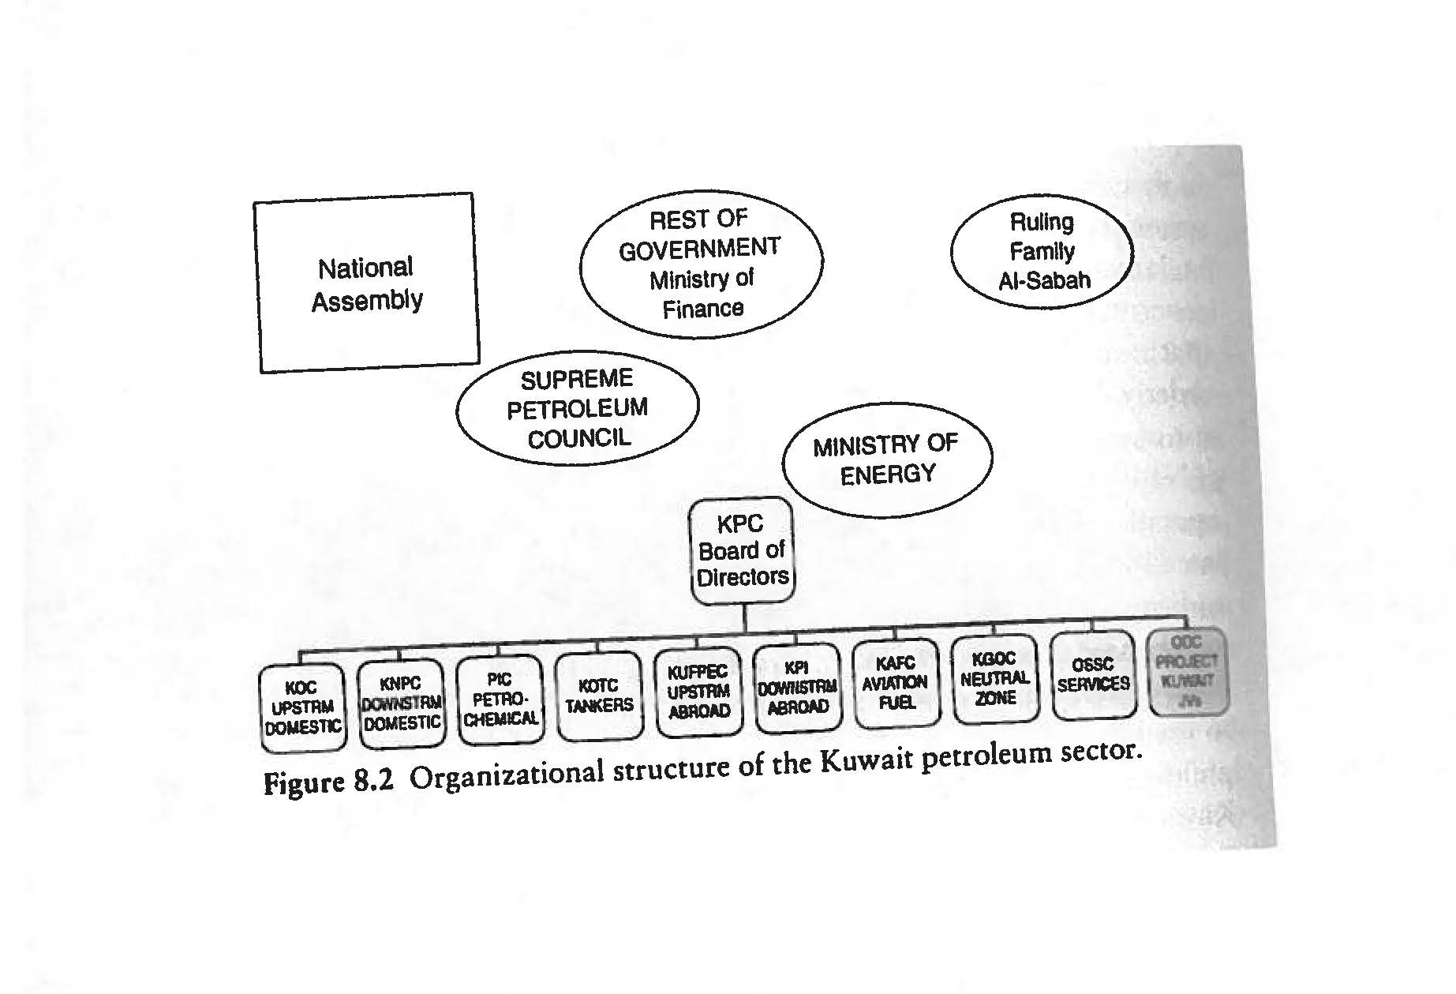
KPC Current Organization

Slide 35
KPC Current Organization
Vertical integration requires clear strategy
Creates more of a cloud than a scheme with clear lines of authority
KPC: empowered only to make recommendations to SPC on personnel and budget
SPC: alone given authority to actually set personnel requirements and send budget forward to gov’t and National Assembly
Founding law split authority between KPC and SPC – its shareholder

Slide 36
KPC
KPC subject to direct governance by SPC
KPC are in an uncertain limbo between private and government sectors
Energy ministry and National Assembly roles are difficult to parse.
Role of National Assembly has no formal role but is required to approve budget and thus creates a large role in spending priorities

Slide 37
KPC’s Performance
Kuwait’s oil sector organized around gov’t – controlled budget system
KOC receives its capital allocation in budget set by gov’t
Refineries are sophisticated but expansion plan for 4th stalled due to expected costs due global construction boom
Refinery capacity utilization sound, some distortion due to two large fires but no signs of shortage
Production cost
  Ave cost 1.29 ($ per bbl) in 2011 to 2005/6 $1.47

Slide 38
Operational Cost and Performance
Numbers shown are extremely low reflecting relatively easy geology
Because easy and low cost, efficiency not high on list of priorities
Project Kuwait was to reverse rising costs due to declining efficiency

Slide 39
Labor Related Performance
Nepotism is rife, many are employed and promoted well beyond capabilities
Kuwaitis receive a degree, return home and placed in management structure a above competent level
Process reinforce by political interference which is difficult to reverse
Interestingly, managers generally “rise from the ranks”
Little lateral movement
Problems of incompetence are poised to grow as the less competent younger generations are promoted from within

Slide 40
National Gas Performance
A new priority
Major field by KOC – March 2006
With Schlumberger expected to supply 1.3 billion cfd
And with IOC’s develops deep horizon gas in northern fields
Goal of reducing flaring from 5.2% to 1%
Gas exploration may be given a higher priority
Possibilities are very attractive

Slide 41
Effect of Core Obligations on Performance
KPC often seen as a source that can be tapped for local benefits
KPP supplies no data as to amount of supply chain from Kuwait companies
KPC done little to catalyze broader economic development
One exception is preference for Kuwait employment
Gov’t statistical bulletin – oil sector accounts for 50% of GDP, accounts for less than 3% of direct employment

Slide 42
Technological Performance
How KPC able to general new technologies
Headquarters includes an R&D division and work driven by needs of subsidiaries
KISR (Kuwait Institute for Scientific Research)
Oil sector relies little on KISR
Conclusion that performance been poor

Slide 43
KPC’s Strategy
Vision – before Iraqi invasion, KPC had clear strategy from Ali Al-Khalifa
Conversion of KPC into a major IOC
Brief time period – had nationalized its oil industry
Newly nationalized company became a basket for all elements
Ali Al-Khalifa, now oil minister relied on two
  Internalize KPC’s activities
  Contain the fallout of the Iran-Iraq War
By 1982, Kuwait crude production fallen to 862 b/d from 2,623,00 b/d

Slide 44
Liberation after 1991
Opportunity to reconsider entire KPC package
A 5 year plan emerged to be approved by KPC board
Set targets – production 3 mbd to 4 mbd by 2020
Increasing refining capacity to 1 million b/d and 1.5 by 2020
KPC pursues triangular approach to downstream
  KPC supplies feed stock which brings management skills, technology, and risk management

Slide 45
KPC and Relationship with Government
National Assembly – plays to popular desires
Kuwait members serve constituencies populated by small number of voters
Since 1991, after reformation, ministry’s role less clear
Vision – 2020 targets are Kuwait’s official party
Rooted in internal discussion – determining crude capacity
2020 – possible call 7 mbb, other indication that max – 4 mbd

Slide 46
Project Kuwait
Most important decision last 20 years
While country in flames, KPC sought and received technical assistance from the IOC’s
5 technical service arguments signed with BP, Chevron, Exxon, Shell, and Total
Were willing to do as focus on quid pro quo
1993 extended to allow investment of upstream under terms of Project Kuwait

Slide 47
Project Kuwait
Maintaining production levels difficult as depletition more difficult as crude reserves became heavier and more complex
Concern over water management in mature fields
4 million b/d of crude by 2020 requires 12 million b/d of water
IOC entry might provide benchmark to allow assessment of KPG performance
Initial proposal of Project Kuwait was rejected by National Assembly
Locked down in “data room”
(Note: See measures taken in 1995 page 363)

Slide 48
Regulation and Competition
Regulation of oil sector and its story holds key to understanding why KPC has difficulties
Begins with Law 19 of 1973 – 2 page piece of legislation
Law intended to allow greater oversight and control (formerly regulated by Western companies)
1975 – a set of regulation appears – turns out were just a Arabic translation of some Canadian regulations
KPC’s efforts to avoid government scrutiny were similar to those that BP and Gulf had made years ago

Slide 49
Regulations
In practice SPC and the ministry share regulatory oversight
SPC as shareholder is more effective
Civil Service Commission provides “back up regulation”
No clear regulatory strategy and the result is a degree of chaos that inhibits operational effectiveness
Government oversight is strongest is in procurement policy which involves State Audit Bureau (SAB)
Some efforts increase referral to CTC to KD 1 million
(Note: See page 367 – Sale of filling stations)

Slide 50
Conclusions
KPC has always a great deal of strategy
Lacking in consistency in political and regulatory oversight to deliver on strategic goals
KPC exposed to interest interference from a system dysfunctional
Decision making in oil sector is complex, cumbersome, unpredictable and horribly bureaucratic
An obvious reform would to be to separate roles of chairman of KPC and oil minister

Slide 51
Conclusions
KPC has some excellent managers, middle level management in KPC and its subsidiaries is exceptionally weak
Root of personnel trouble is loss in 1991 of top talent and inability to derive a scheme to identify, train, and promote the most talented workforce
Kuwait or KPC operates on a different legal biases
The gridlock created by political structure

Slide 52
The Future
Prospects are not bright may get worse
National Assembly expected to seek greater role in oil sector
A certain solution would be a fundamental reform of the political system – no longer appointed by the emir
Would reduce the emirs role to constitutional monarch
Political system has effectively stalled entry of IOCs whose presence is essential – could become worse

Slide 53
The Authors Say
Thus KPC is hamstring – by Kuwait and by its own decisions – in managing its response to an array of serious challenges. If oil prices are low for several years – or production costs continue to rise – then Kuwaiti society will find itself accustomed to an expensive lifestyle that it is unable to afford.

